Slide 1
Deep History Of the Study of Perception
By: Ahmed Nadeem

Slide 2
Warning
- Background Color indicates progression through time
BCE and Middle ages
Recent History
Present Day

Slide 3
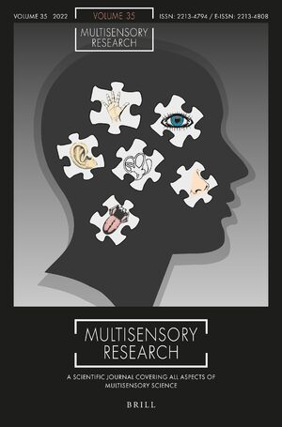
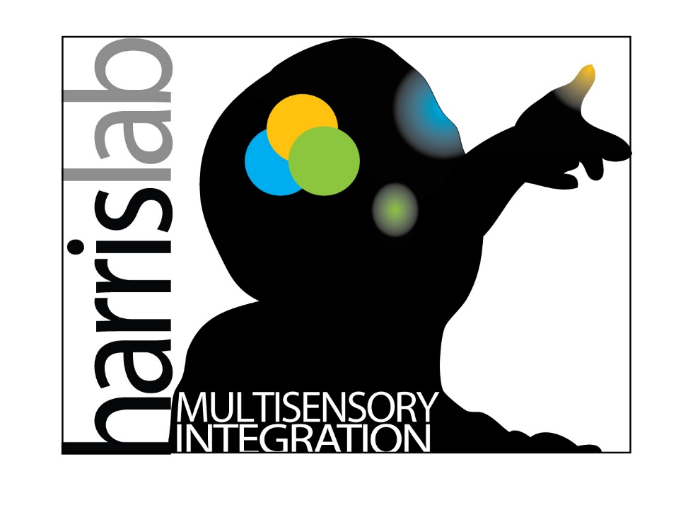
Content / Biological Topic
Before we begin
Notes:
Give a run down of who you are and what you do
I study haptic sense perception
This means I study a lot of, how do people understand and process what they see. Is what they see real/or is there a bias or misleading aspect in how human beings, how the homo sapien species perceives the world.
I mainly work on hpatics which means touch, I like to focus around the hands but I plan to study haptic perception across the body and perhaps around the lower appendges.
The purpose of this work, for those who are curious is to develop better VR and AR experinces and make these systems for the future more refined and better suited for human use and exploration.

Slide 4
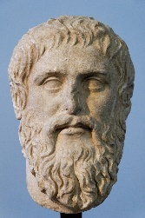
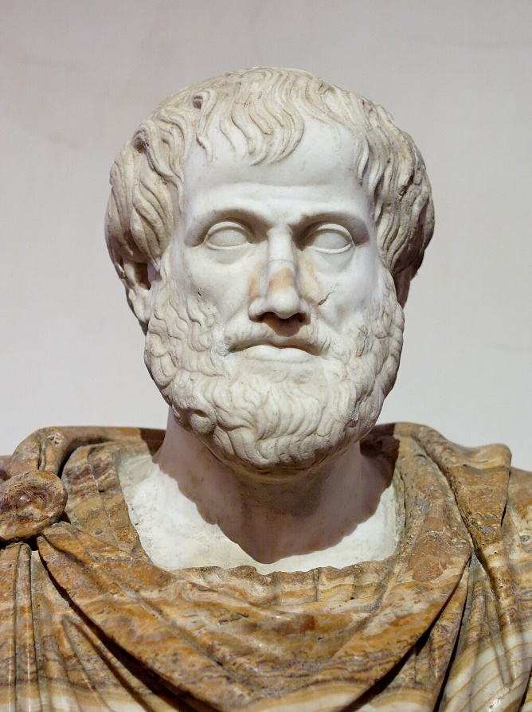
Ancient Philosophers
- go over and study these ideas
Theory of forms (we cant see real reality)
Empiricism -> sensory knowledge is what we have to study reality

Slide 5
Ancient Philosophers PT.2
- Euclid (physics)
herophilus (300 SC)
Aelius Galenus or Claudius Galenus (200 BCE)

Slide 6
Pre Scientific revolution

